Slide 1
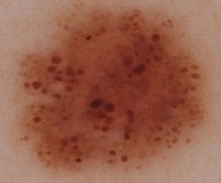
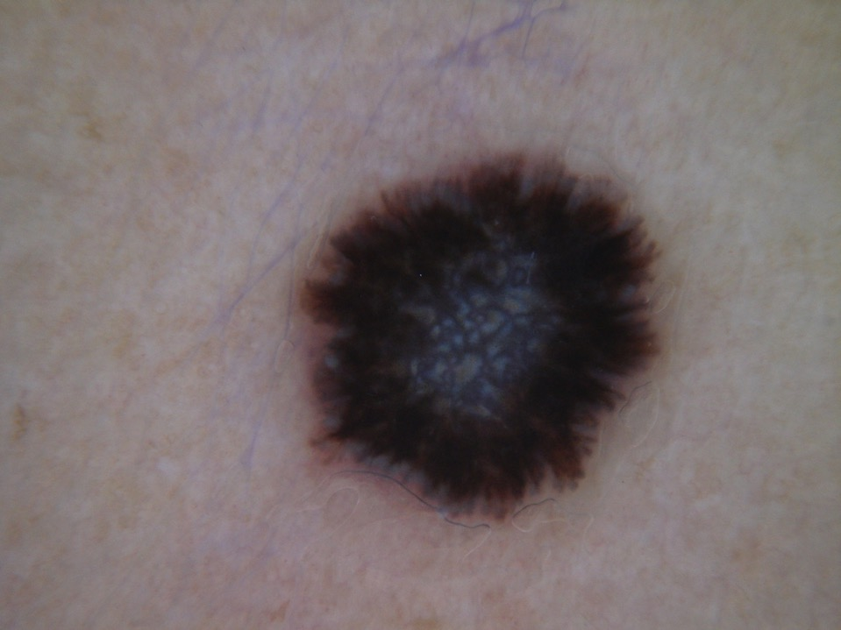
Tutorial on Dots/Globules and Streaks
There are many dermsocopic features used by clinicians to distinguish melanoma (cancer) from benign skin lesions
For this Challenge we have focused on two features: Dots/Globules and Streaks
This brief PowerPoint presentation describes these features

Slide 2
Dots/Globules
Dots and Globules are symmetrical, round to oval, well demarcated structures
Globules are > 0.1mm diameter and Dots are <0.1mm with a few other distinguishing features
For the purposes of the challenge, for simplification we have combined dots and globules into a single feature: ‘Dots/Globules’
For the tutorial we explain dots and globules separately to provide context about how the terms are used clinically

Slide 3
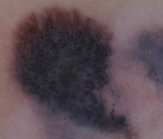
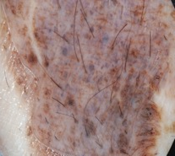
Globules
symmetrical, round to oval, well demarcated structures
> 0.1mm diameter
nests of pigmented melanocytes at dermo-epidermal junction, or in dermis
brown, black, blue

Slide 4
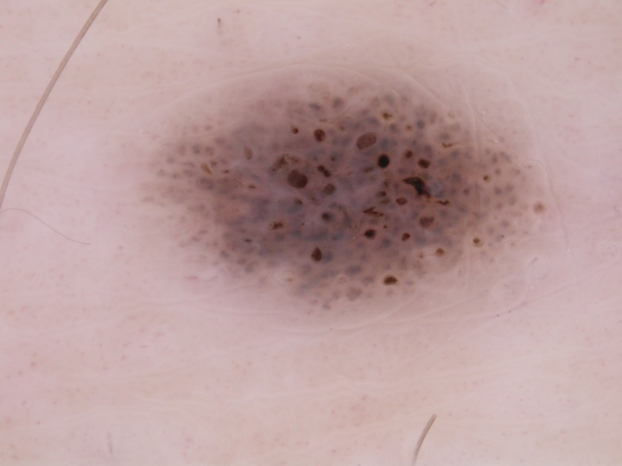
4

Slide 5
The color of globules

Slide 6
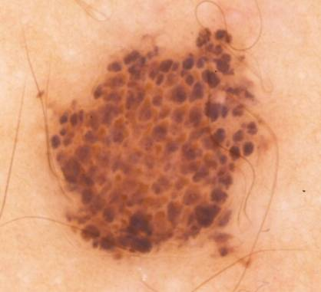
Brown globules (clods, brown, small, round or oval)

Slide 7
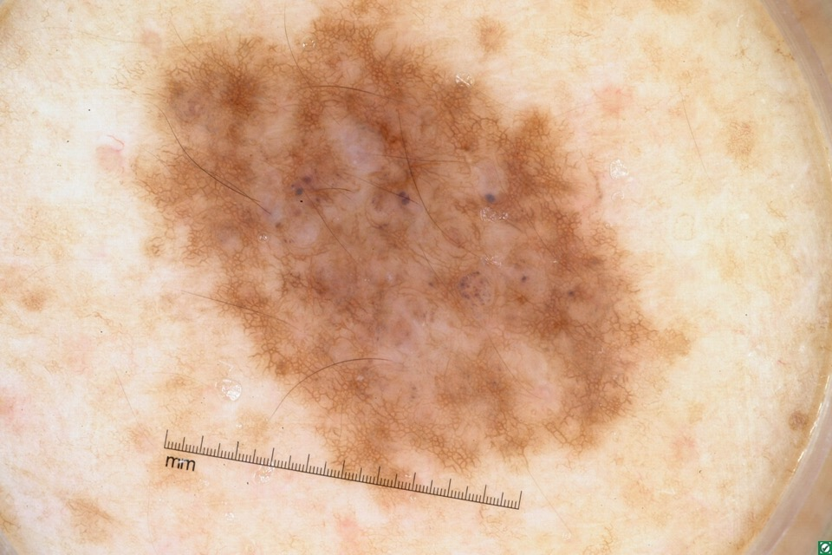
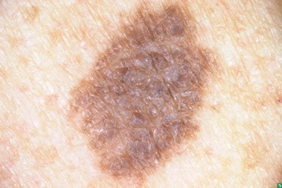
Blue globules (clods, blue, small, round or oval)
3/4/2005
Notes:
3/4/2005Esther C Fuhrman

Slide 8
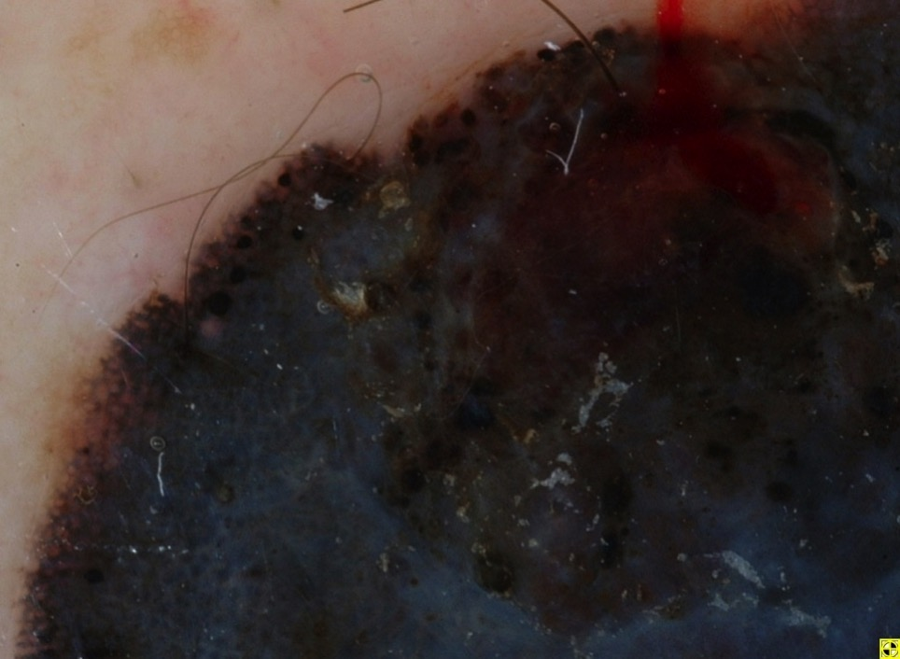
Black globules (clods, black …)
Notes:
William Chalupski35116651

Slide 9
The shapes of globules

Slide 10
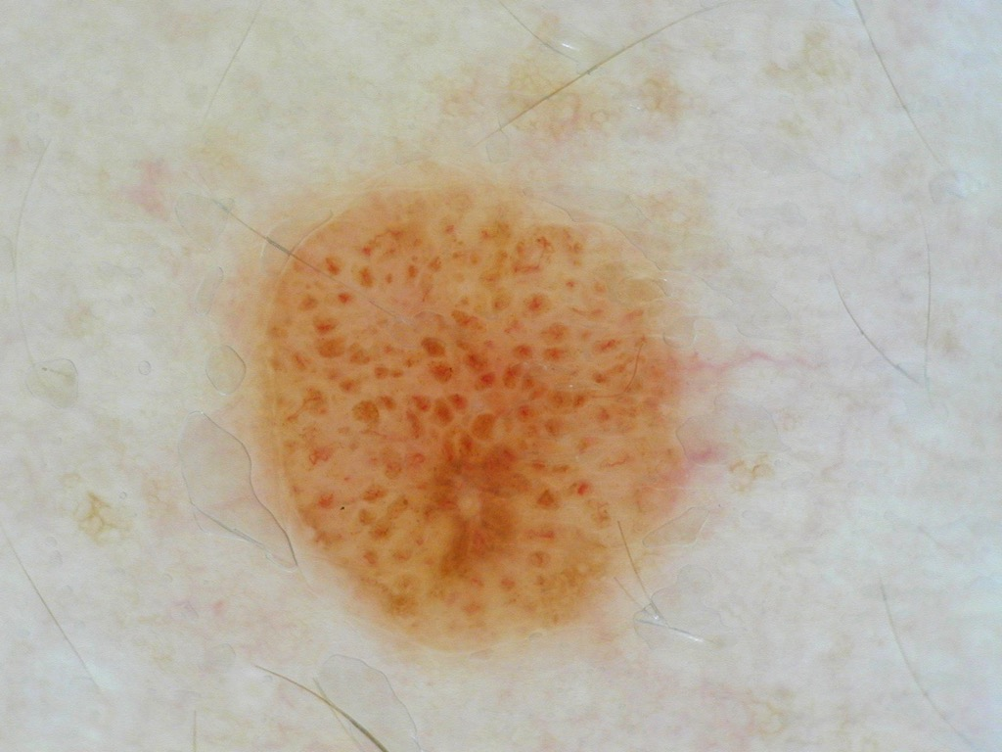
Round to oval

Slide 11
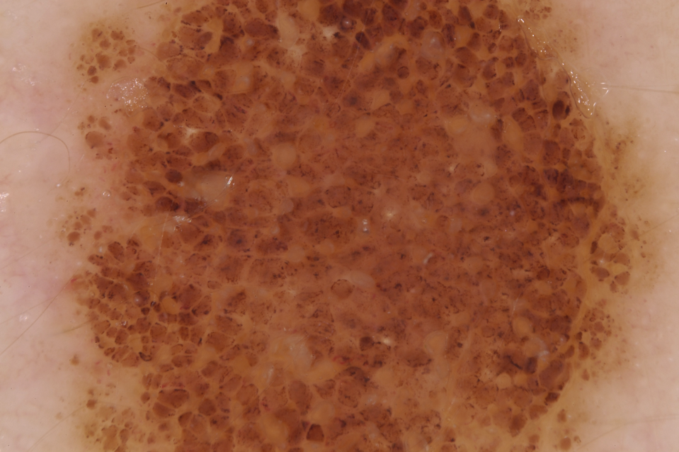
Cobblestone (clods, large, polygonal)

Slide 12
Dots
small, round structures with a diameter< 0.1 mm
black, brown, blue-gray, or red
black dots = pigment in the stratum corneum and the upper part of the epidermis
brown dots = small nests at or near the dermo-epidermal junction or in epidermis (below stratum corneum)
blue-gray dots = free melanin in dermis or in macrophages (discussed in regression structures section)

Slide 13
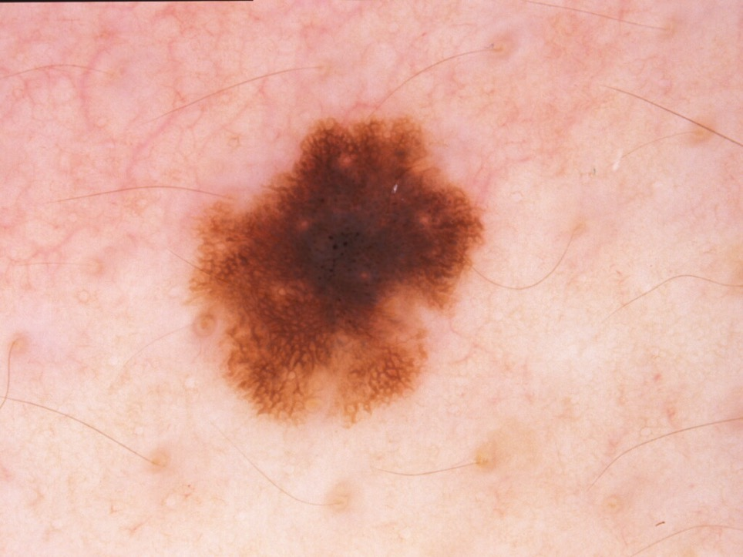
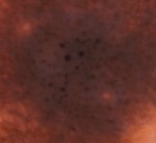
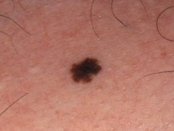
Black Dots
Nevus

Slide 14
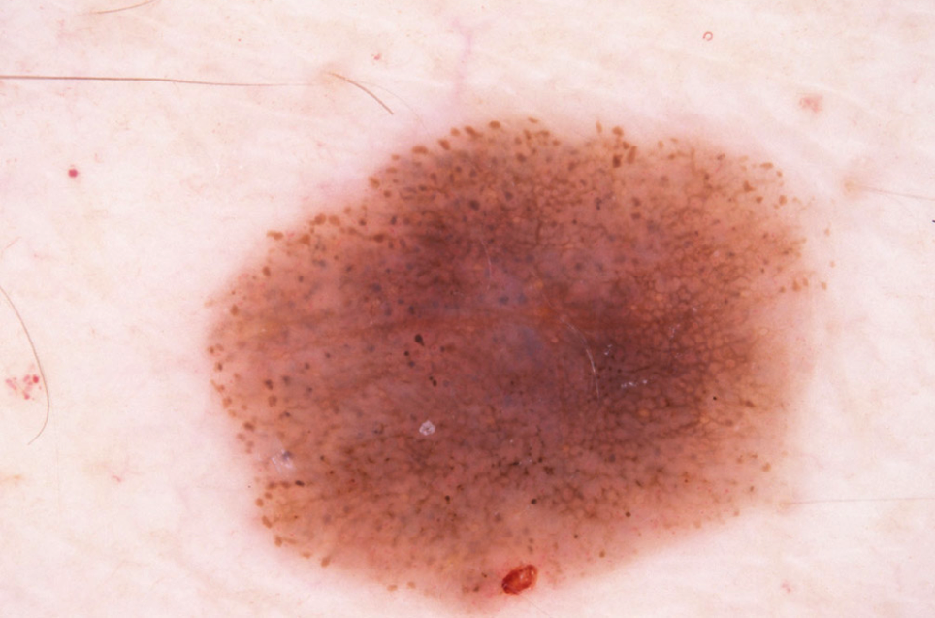
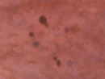
SSM 0,3mm
Brown dots not on the network

Slide 15
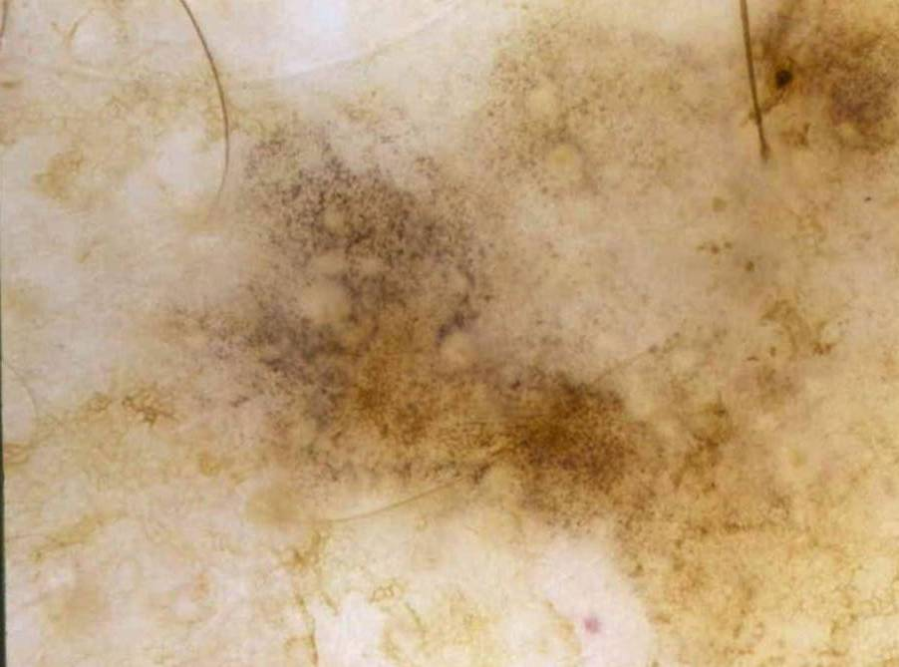
Blue-Gray dots

Slide 16
Definition of streaks
Streaks are projections at the periphery of the lesion extending towards normal skin
The center or ‘body’ of the lesion can be composed of a relatively homogeneous ‘blotch’ of color OR be composed of a lace like ‘network’ of color.
The appearance of streaks varies based on whether they are extensions off of a blotch like ‘tumor body’ or a lace like central ‘network’. The following slides describe these two scenarios.

Slide 17
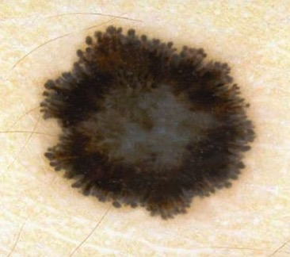
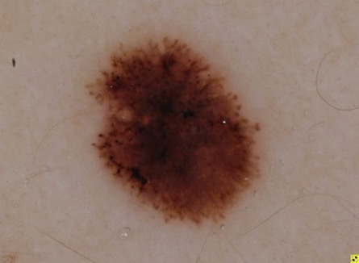
Streaks

Slide 18
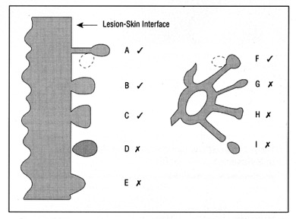

Definition of streaks
Linear pigmented projections extending from tumor towards normal skin.
Modified from Menzies et al. 1995
Linear extensions emanating from & directly connected to the main tumor mass are considered streaks. They may taper off towards the periphery.
Linear extensions emanating from the pigment network are considered streaks if they have at least the same thickness as the atypical network from which they arise. They do not usually taper off distally & no network lines can branch off from them.

Slide 19
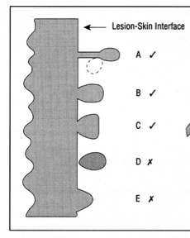
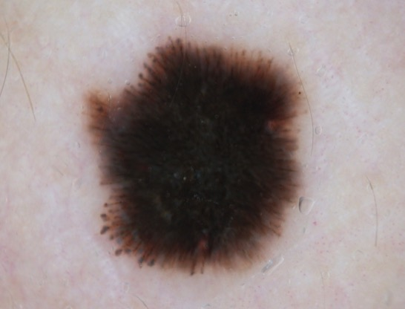
Streaks off tumor body
Modified from Menzies et al. 1995
Linear extensions emanating from & directly connected to the main tumor mass are considered streaks. They may taper off towards the periphery.

Slide 20
Starburst with radial streaming
Courtesy of Adam Korzenko
Notes:
Reeds by Korzenko

Slide 21
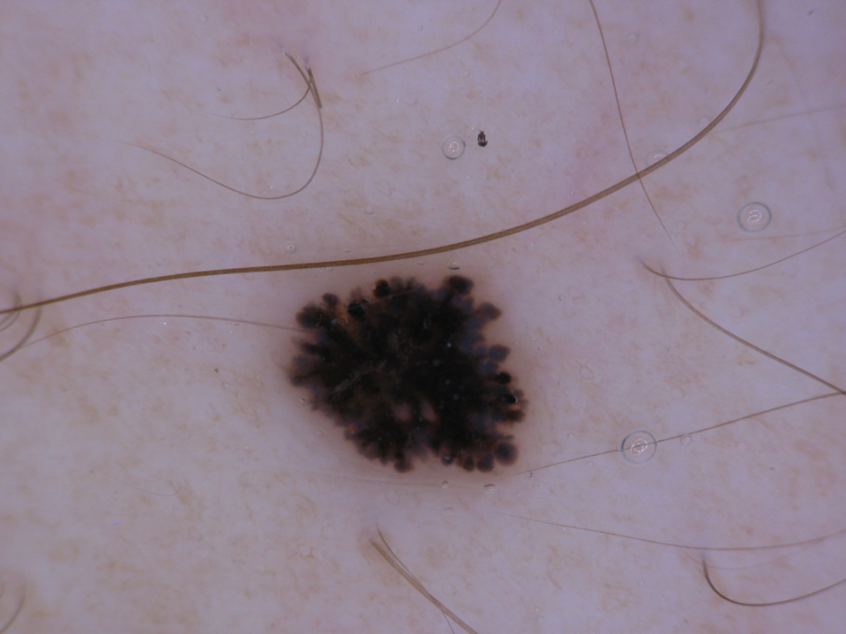
Starburst with pseudopods

Slide 22
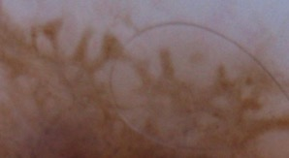
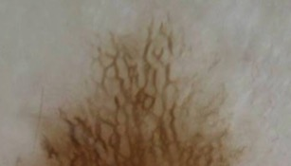
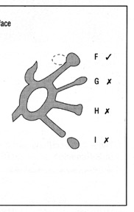
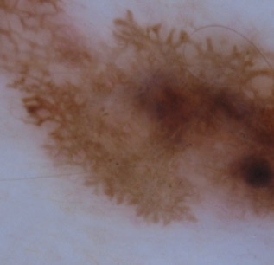
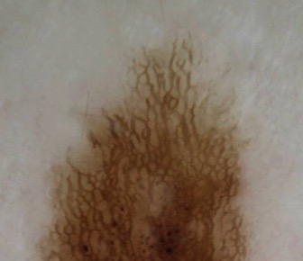
Streaks off network
Arise off an atypical network
Have at least the same thickness as the atypical network from which they arise.
Are linear & non-branching
Usually do not taper off
These are not streaks since they are:
1. not linear
2. have branching points
3. not connected to an atypical network,
4. taper off towards the periphery.

Slide 23
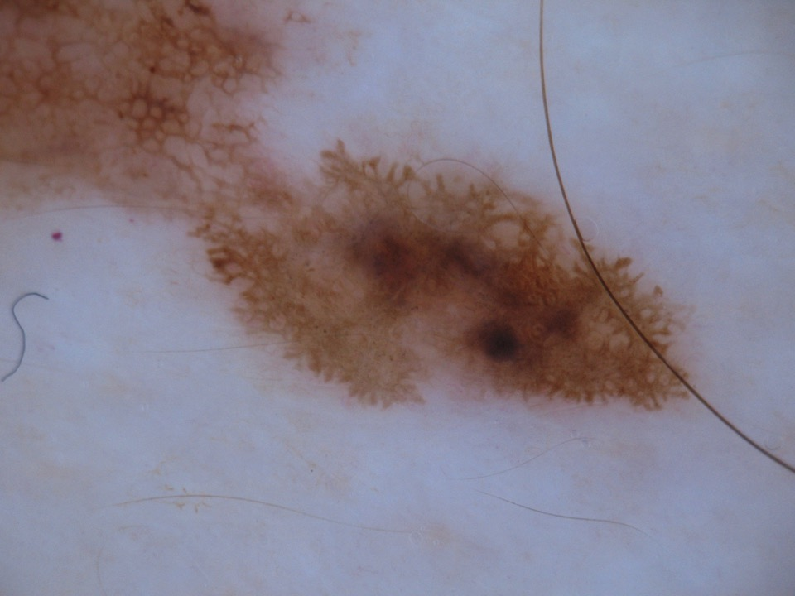
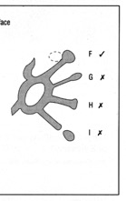
Linear extensions emanating from the pigment network are considered streaks if they have at least the same thickness as the atypical network from which they arise.

Slide 24
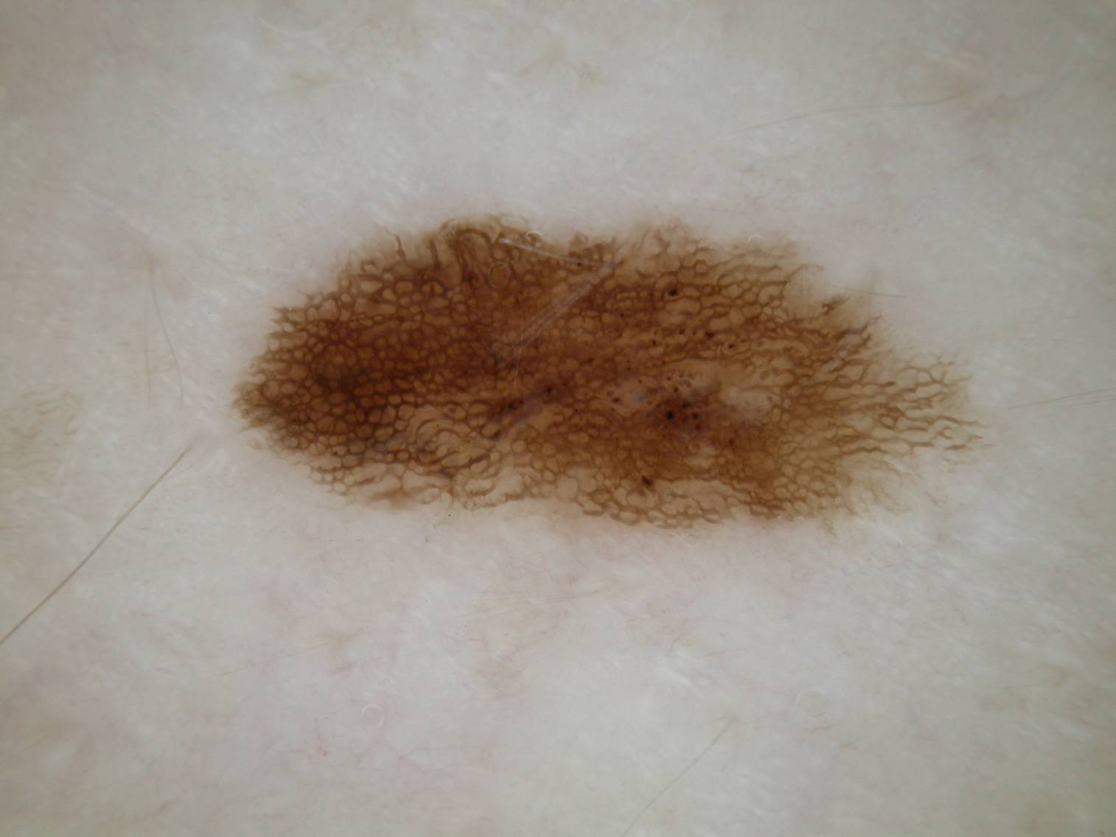

The extensions emanating from the pigment network in this lesion are not considered streaks since they are not linear (most show evidence of branching), are not connected to an atypical network, and because they taper off towards the periphery.

